Slide 1





JNTUA College of Engineering,
Pulivendula
Placement Report
2018-19

Slide 2


Success has been a part of our achievements. It has been increasing year by year. The main motto of our department is to give a bright future with a keen knowledge in upcoming technologies. We improvise the thinking ability of our students.
In the 2015-19,Students were placed in 7 different companies(TCS, INFOSYS,CTS,MINDTREE,WIPRO,VIRTUSA POLORIS,SYNTEL).In this year 51.8% of the students were recruited .

Slide 3
Total no. of students eligible for placements | 54
No. of students opted for deferred placements | 54
No. of offers received through final placement process | 28
Total no. of offers received | 28
An average salary for the top quartile at Rs. 4.5 Lakh Per Annum (LPA). Out of which 22.2% of our students were placed in TCS, 12.9% in INFOSYS, 20.3% in CTS, 5% in MINDTREE, 7.4% in WIPRO, 5% in VIRTUSA COLORIS , 5% in SYNTEL.

Slide 4
Placement Report
Students placed
Higher Studies
51.8%
12.9%
Offers to students
Other Streams
28 Students were placed in 7 different companies
4 of the students were pursuing higher studies,3 GATE rankers and 1 as intern

Slide 5
Higher Education
Students who have
Underwent GRE and IELTS exam
D.Harsha Praneeth
Cau Keil,Germany on
Computer Science
K.Tharun
Cau Keil,Germany on Computer Science
G.V.R.Sree Vastava
Cincinnati University,U.S.A on Data Science
P.Siva Nanda Reddy
Trier University,Germany on Data Science

Slide 6
Software stream
Gender Diversity
11.1% Placed
40.7% Placed

Slide 7
Campus Recruitment

Slide 8








Slide 9
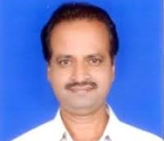
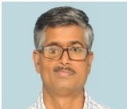

Get a modern PowerPoint
Our Team
Dr.G.Murali
Prof G.Sankar Sekhar Raju
Prof G.V.Subba Reddy
Principal of JNTUA College Of Engineering,Pulivendula
Vice –Principal of JNTUA College Of Engineering,Pulivendula
Head Of the Department,CSE

Slide 10
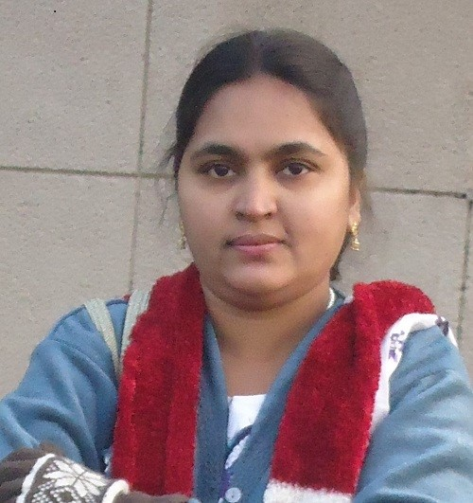
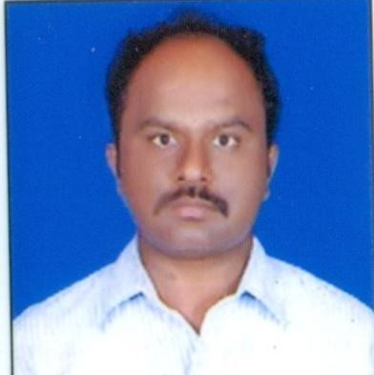
Get a modern PowerPoint
Our Team
Dr.S.J.Saritha
K.V Siva Prasad Reddy
Placement Officer of JNTUA College Of Engineering,Pulivendula
Placement Officer Staff Head of JNTUA College Of Engineering,Pulivendula

